Slide 1

Regularizing your neural network
Dropout
regularization
deeplearning.ai

Slide 2
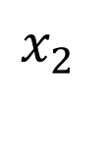

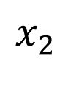
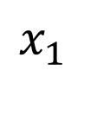
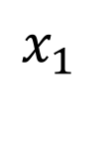
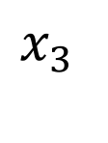
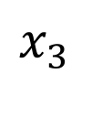
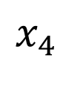
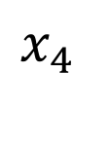


Dropout regularization
$$x_{1}$$
$$x_{1}$$
$$x_{2}$$
$$x_{2}$$
$$\hat{y}$$
$$\hat{y}$$
$$x_{3}$$
$$x_{3}$$
$$x_{4}$$
$$x_{4}$$

Slide 3
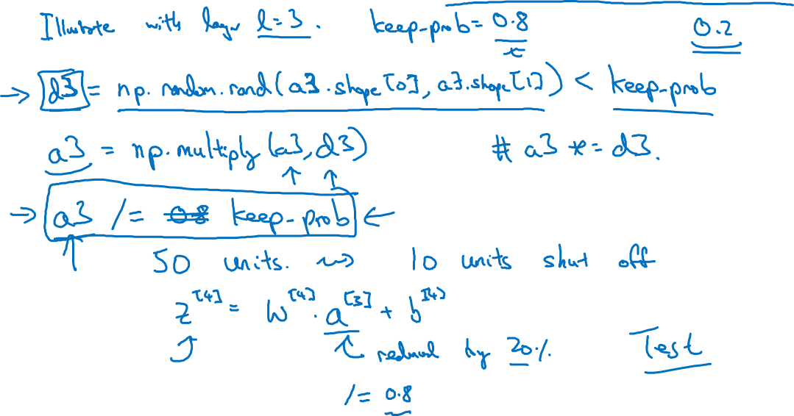
Implementing dropout (“Inverted dropout”)

Slide 4
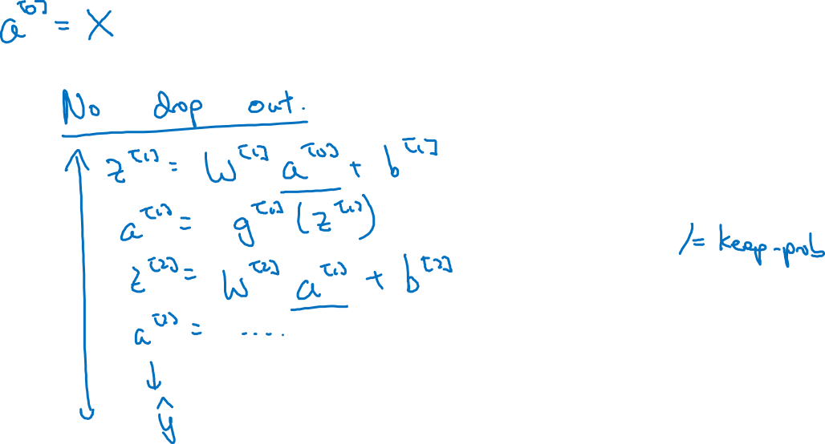
Making predictions at test time

Slide 5
Regularizing your neural network
Understanding
dropout
deeplearning.ai

Slide 6

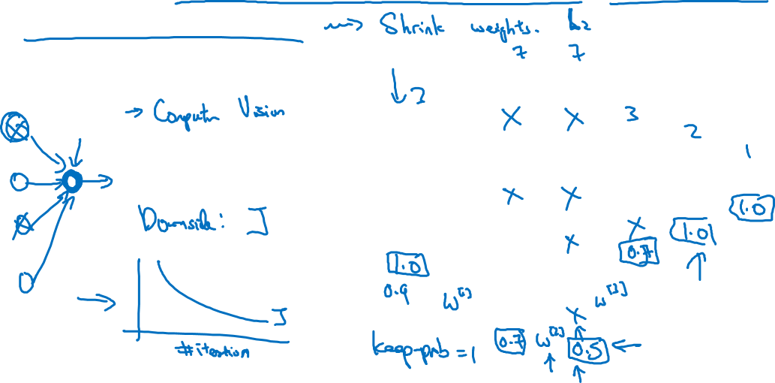



Why does drop-out work?
Intuition: Can’t rely on any one feature, so have to
spread out weights.
$$x_{1}$$
$$x_{2}$$
$$\hat{y}$$
$$x_{3}$$

